Slide 1
The GDPR and how it works
Dr Maria Grazia Porcedda
Assistant Professor in IT Law
March 25th, 2024
Notes:
Clarify legal responses

Slide 2

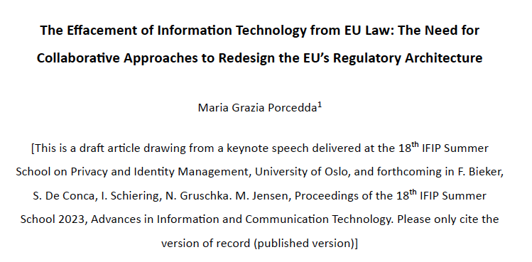
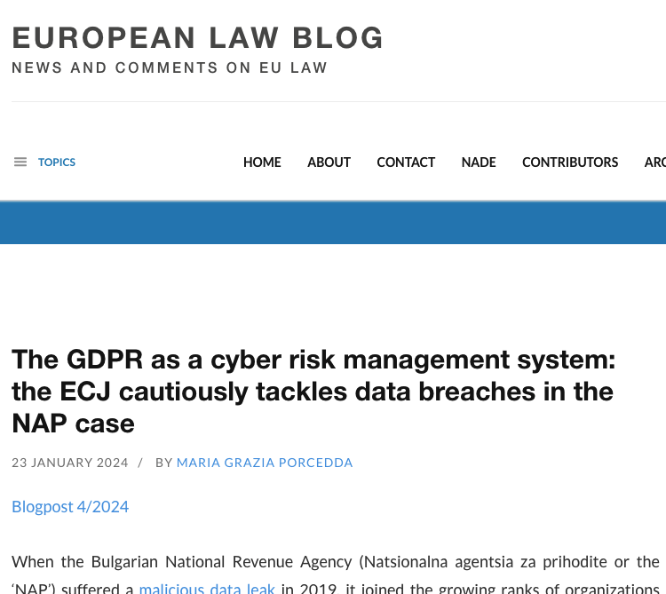
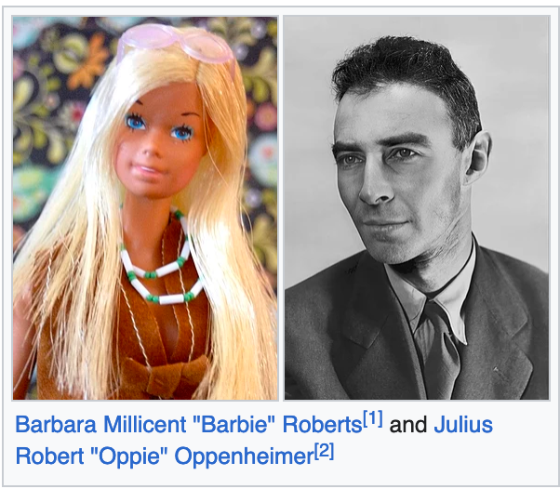
A few words about myself and the sources of this class

Slide 3
The GDPR and how it works : contents
Moral entitlements
Part 2
Part 1
Primary law
Secondary law
Other ‘law’
Technology
Charter, TFEU
GDPR
Part 3
National laws, international standards
Technical measures
Part 4
Adapted from Porcedda (forthcoming 2024)
©2024 Maria Grazia Porcedda
Notes:
“Why walk down stairs when you can slide into your pool? Why trudge up stairs when you take an elevator that matches your dress?”

Slide 4
Part 1: to understand GDPR you need to understand data protection (and privacy before it)
Moral entitlements
Part 2
Primary law
Secondary law
Other ‘law’
Technology
Charter, TFEU
GDPR
Part 3
National laws, international standards
Technical measures
Part 4
Adapted from Porcedda (forthcoming 2024)
©2024 Maria Grazia Porcedda
Notes:
“Why walk down stairs when you can slide into your pool? Why trudge up stairs when you take an elevator that matches your dress?”

Slide 5
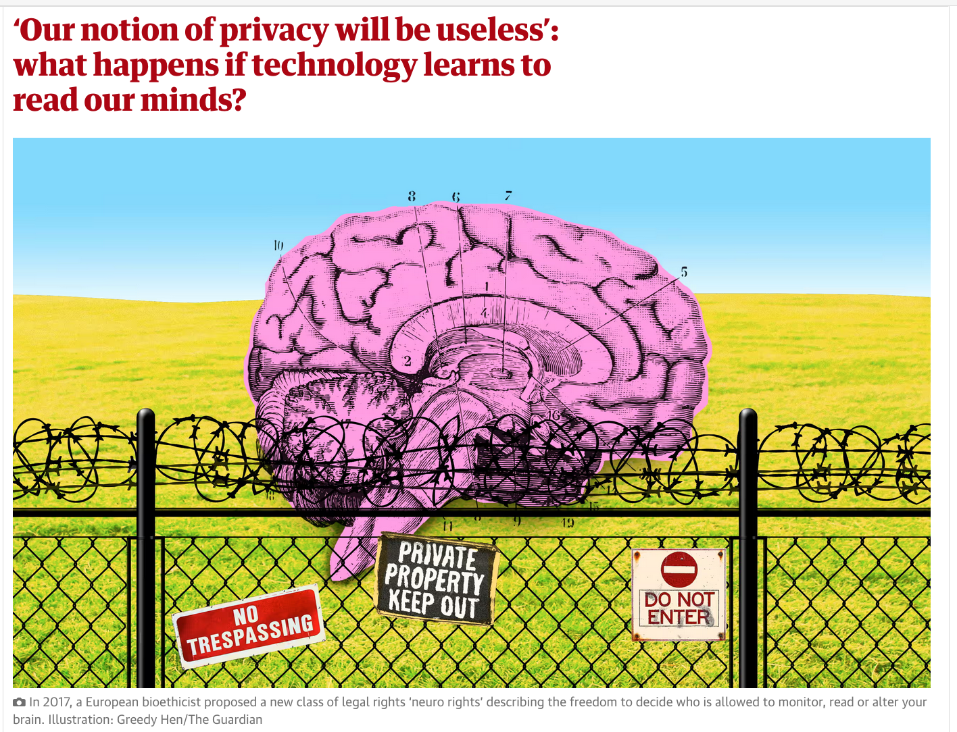

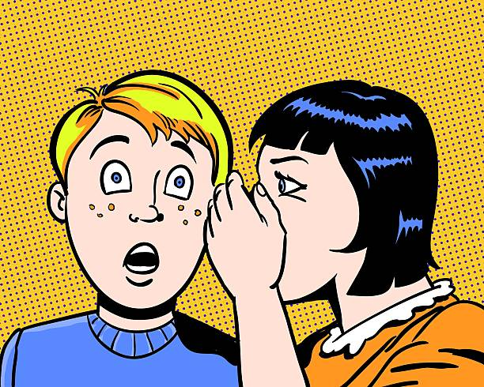
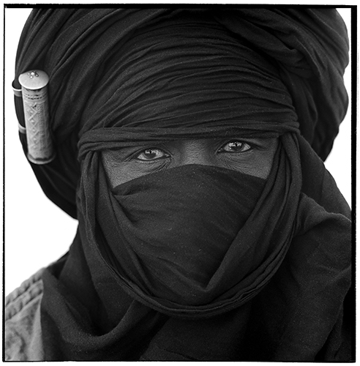

Privacy as intimacy: nature or nurture?
Nature?
Nurture?
psychology
https://dictionary.apa.org/privacy
David Attenborough on animal privacy
https://cdn.theguardian.tv/mainwebsite/2016/10/18/161018AttenboroughGorillaHighRes_desk.mp4
Intimacy: Needed to build one’s identity, supports autonomy & dignity
Personal, emotional, physical and mental boundaries
Varies across time and space
Sources: https://www.wired.com/1999/01/sun-on-privacy-get-over-it/; https://www.theguardian.com/technology/2021/nov/07/our-notion-of-privacy-will-be-useless-what-happens-if-technology-learns-to-read-our-minds; https://www.theguardian.com/world/2016/oct/18/david-attenborough-zoos-respect-gorillas-privacy-peepholes
©2024 Maria Grazia Porcedda
Notes:
https://www.psychologytoday.com/ie/blog/emotional-nourishment/202007/the-importance-privacy-both-psychological-and-legal; https://www.psychologytoday.com/ie/blog/emotional-nourishment/202007/the-importance-privacy-both-psychological-and-legal; https://www.sciencedirect.com/science/article/abs/pii/S0272494497900499; https://compass.onlinelibrary.wiley.com/doi/full/10.1111/spc3.12507
What is privacy? Expresses the universal need of control over intimacy. An elusive term, which concerns one person, as well as her relationshops, and the boundaries he/she chooses to place
Where: curtains, Tuareg
how/why: build identity, characterize each one of us as a different being bearer of dignity, supports autonomy

Slide 6
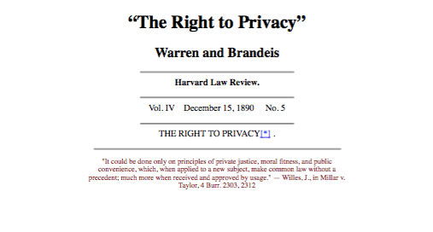
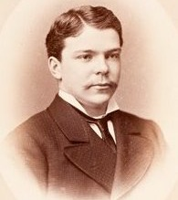

Technology and the birth of “Privacy”
1800 Constitutions: sanctity of homes and confidentiality of communications (but no common law right/tort)
Source: https://en.wikipedia.org/wiki/File:Samuel_Dennis_Warren_by_William_Notman,_c1875.jpg
Author: Håkan Svensson
Source: https://upload.wikimedia.org/wikipedia/commons/d/d7/Brownie2_overview3.jpg
©2024 Maria Grazia Porcedda
Notes:
Some constitutions acknowledged elements of privacy, but the merit for popularising the concept are to do with Warren and brandeis
Who they were, parted, Warren married..spotlight…
Right to personality…(if pictures are protected, graphic descriptions should be too), tort law
Marries Mabel Bayard (1883), daughter of senator Bayard
How: private law
Why: intrusion into private sphere by technology

Slide 7
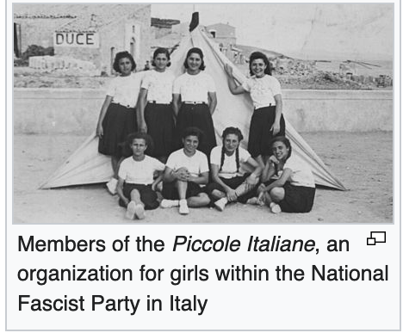
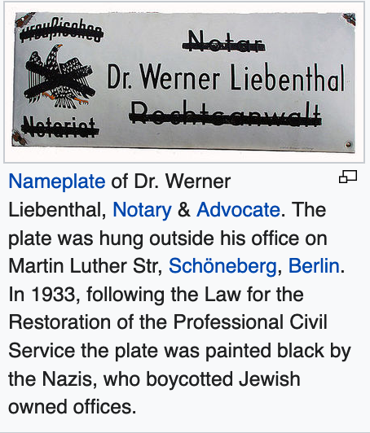
Privacy & WWII, fascism and totalitarianism
Challenges to identity, autonomy and dignity, e.g.:
Regimentation of children (personal development)
Prohibition to exercise one’s profession (identity, social relations)
Restrictions on freedom to marry (family)
Lists of ‘enemies of state’ (based on ethnicity/religion/political views)
Forced labour
Expulsion
Physical elimination
Images: https://en.wikipedia.org/wiki/Fascism; https://en.wikipedia.org/wiki/Law_for_the_Restoration_of_the_Professional_Civil_Service
©2024 Maria Grazia Porcedda

Slide 8


«NEVER AGAIN»: Post-WWII legal order and the right to respect for private life (privacy)
Art. 12 UDHR (1948)
No one shall be subjected to arbitrary interference with his privacy, family, home or correspondence, nor to attacks upon his honour and reputation. Everyone has the right to the protection of the law against such interference or attacks.
1966. International Covenant on Civil and Political Rights (ICCPR)
1950. European Convention on Human Rights (ECHR)
©2024 Maria Grazia Porcedda
Notes:
UDHR: different status, but influenced two binding formultation of rights
There exist differences

Slide 9
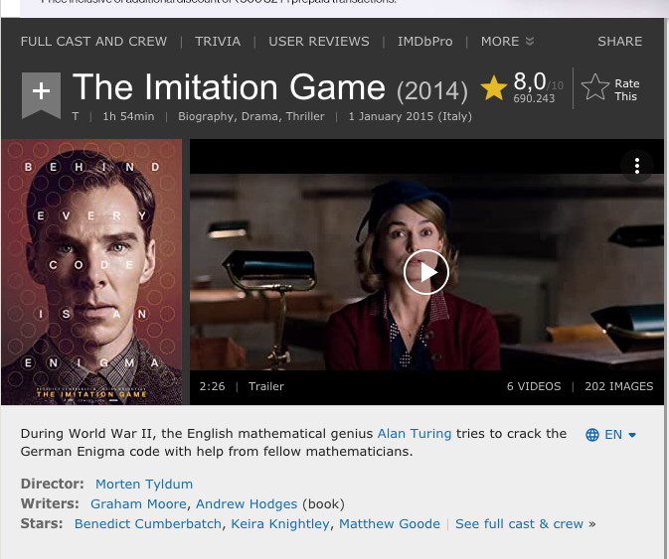
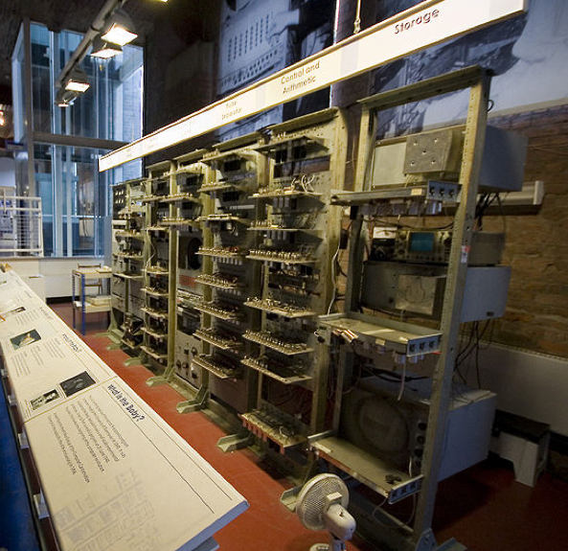
Data protection / information privacy not yet conceptualised: computing was in its infancy in the 1950s!
1800s
Databases for admin (e.g. census)
1940s
Automation by early programmable computers
1800s – 1930s
Automation by punched cards and card sorting systems
1940- 1950s Stored-programme computers
Trailer: https://www.youtube.com/watch?v=nuPZUUED5uk; Replica of B-A-B-Y, Author: Tom Jeffs. Source: https://en.wikipedia.org/wiki/Manchester_Small-Scale_Experimental_Machine;
©2024 Maria Grazia Porcedda
Notes:
Techno-trigger: encounter of …
Found applciation in…
First, dreadful example of how things could go wrong…
This was before computers
Baby could subtract and negate by default; other operations were added by software
52 minutes to calculate 2x18

Slide 10

Even without computers, data collection could harm
https://ibmandtheholocaust.com/
Tabulator/ card sorting system
©2024 Maria Grazia Porcedda

Slide 11
Uptake of data processing by private and public sectors
Databanks in Land of Hessen: processing health and income-related data →Data Protection Act 1970
Parallel conversations elsewhere: Sweden (1973); United States (1973 report*)
“While recent scientific discoveries and technological advances have opened vast prospects for economic, social and cultural progress, such developments may nevertheless endanger the rights and freedoms of individuals and will require continuing attention.” (1973 UN Proclamation of Teheran, § 18)
A. Enhance data flows
B. Protect human rights
Fair information/
data protection principles
* https://www.justice.gov/opcl/docs/rec-com-rights.pdf
©2024 Maria Grazia Porcedda
Notes:
Spread
Decision to adopt principles to satisfy different needs …embodies by two different international documents
“if it can be done, should it be done?

Slide 12

Data protection becomes information privacy and, in the EU, a self-standing right
Art. 12 UDHR (1948)
1950. European Convention on Human Rights (ECHR)
1966. International Covenant on Civil and Political Rights (ICCPR)
IE Human rights Act 2003 & Irish constitution
2001. Charter of Fundamental Rights of the European Union
Right to privacy +
right to data protection
©2024 Maria Grazia Porcedda
Notes:
UDHR: different status, but influenced two binding formultation of rights
There exist differences

Slide 13
Part 2: explaining this funny diagram
Moral entitlements
Primary law
Secondary law
Other ‘law’
Technology
Charter, TFEU
GDPR
National laws, international standards
Technical measures
Adapted from Porcedda (forthcoming 2024)
©2024 Maria Grazia Porcedda
Notes:
“Why walk down stairs when you can slide into your pool? Why trudge up stairs when you take an elevator that matches your dress?”

Slide 14
Moral entitlements are empty without legal grounding
They need a hook in primary or constitutional law
Article 8 of the Charter
Everyone has the right to the protection of personal data concerning him or her
Primary law
Article 16 of the Treaty on the Functioning of the EU
1. Everyone has the right to the protection of personal data concerning them.
2. The European Parliament and the Council, acting in accordance with the ordinary legislative procedure, shall lay down the rules relating to the protection of individuals with regard to the processing of personal data by Union institutions…and by the Member States when carrying out activities which fall within the scope of Union law….
©2024 Maria Grazia Porcedda
Notes:
“Why walk down stairs when you can slide into your pool? Why trudge up stairs when you take an elevator that matches your dress?”

Slide 15
Article 16 TFEU gives power to adopt GDPR, which reconciles rights with free flow of data
Primary law
Secondary law
Charter, TFEU
General Data Protection Regulation (EU) 2016/679, OJ L 119, p. 1-88
GDPR
Rights of data subjects (Art. 1.2)
Free flow of data (Art. 1.3)
©2024 Maria Grazia Porcedda
Notes:
“Why walk down stairs when you can slide into your pool? Why trudge up stairs when you take an elevator that matches your dress?”

Slide 16
Even if it’s 88 pages long, GDPR does not resolve everything!
Primary law
Secondary law
Other ‘law’
The GDPR is enforced by EU member states (eg Ireland).
Enforcement requires national laws
Charter, TFEU
GDPR
National law, international standards
The GDPR says we must adopt technical and organisational measures to protect data, but not which measures
©2024 Maria Grazia Porcedda
Notes:
“Why walk down stairs when you can slide into your pool? Why trudge up stairs when you take an elevator that matches your dress?”

Slide 17
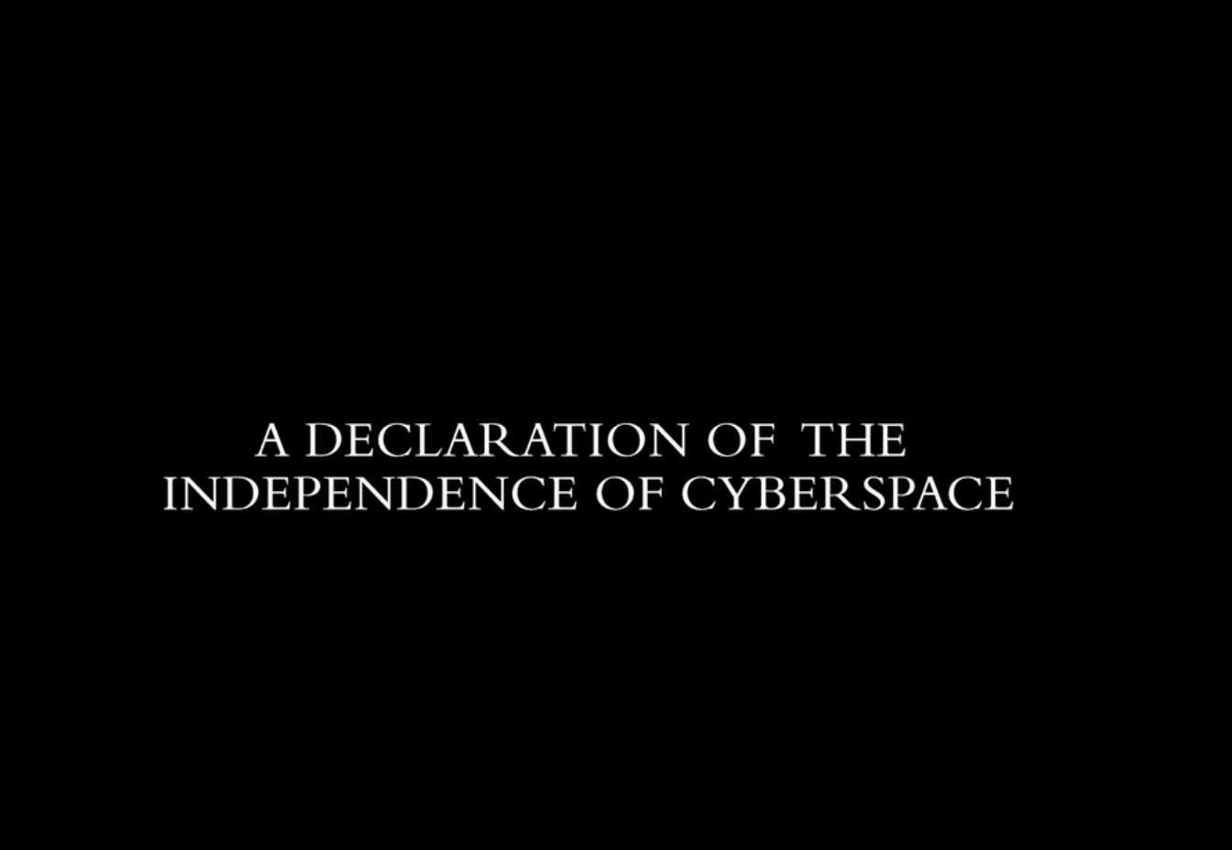
Technical measures = technology, which has regulatory power
Primary law
Secondary law
Other ‘law’
Technology
Charter, TFEU
GDPR
Naitonal laws, international standards
Watch at: https://www.youtube.com/watch?v=3WS9DhSIWR0 (until 3’30’’)
Technical measures
Reidenberg (1998) Lex Informatica
Lessig (1999) Code is Law
©2024 Maria Grazia Porcedda
Notes:
“Why walk down stairs when you can slide into your pool? Why trudge up stairs when you take an elevator that matches your dress?”

Slide 18
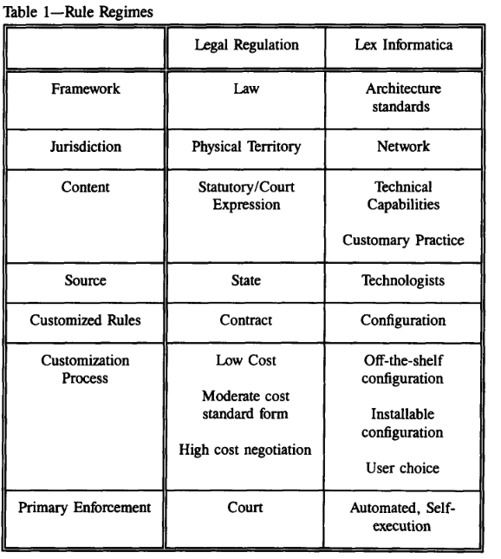
Reidenberg (1998) Lex Informatica
technological architectures impose effective external regulation
“technological defaults and system configurations [form] two types of substantive rules: immutable policies embedded in the technology standards that cannot be altered and flexible policies embedded in the technical architecture that allow variations on default settings. (p. 555)”
→ Changes by designers or legislators
Design-based legislation: Internet design choices affect regulatory options
© Maria Grazia Porcedda 2024

Slide 19
Lawrence Lessig’s modalities of regulation over the pathetic dot
The Law of the Horse: What Cyberlaw Might Teach (1999) 4 modalities of regulation:
Norms: constrain behaviour through community
Law: directs behaviour by threatening ex post sanctions
Market: regulate through price
Architecture: the world as we find it restricts or enables behaviour
“Pathetic dot”
Four modalities (direct/indirect) affect the pathetic dot
Lessig (2006) p. 123
© Maria Grazia Porcedda 2024
Notes:
These four modalities affect the indiviudal or pathetic dot

Slide 20
BREAK
Notes:
Clarify legal responses

Slide 21
Part 3: the GDPR and its main features
Moral entitlements
Primary law
Secondary law
Other ‘law’
Technology
Charter, TFEU
GDPR
Data protection by design standard
Technical measures
Adapted from Porcedda (forthcoming 2024)
© Maria Grazia Porcedda 2024
Notes:
“Why walk down stairs when you can slide into your pool? Why trudge up stairs when you take an elevator that matches your dress?”

Slide 22
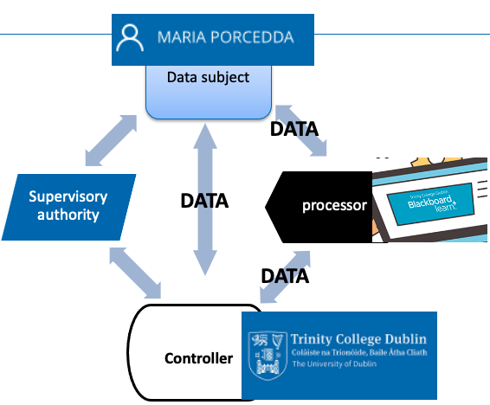
The rationale and architecture of the GDPR
Recital 1 The protection of natural persons in relation to the processing of personal data is a fundamental right. (…)
Recital 2 This Regulation is intended to contribute to the accomplishment of an area of freedom, security and justice and of an economic union, to economic and social progress (…)
A. Protect human rights
B. Enable data flows
GDPR
© Maria Grazia Porcedda 2024

Slide 23
The data protection architecture: 1. (processing of) personal data (Art 4(1))
Data subject
→ Any information
relating to an identified or identifiable
natural person (‘data subject’);
→ Rec 27 no deceased person | Rec 14 whatever the persons’ nationality or residence,
Identifiable = can be identified, directly or indirectly, in particular by reference to an identifier such as a name, an identification number, location data, an online identifier or to one or more factors specific to the physical, physiological, genetic, mental, economic, cultural or social identity
DATA
Supervisory authority
processor
DATA
DATA
Controller
Art. 9 Special categories of personal data
Art. 10 data relating to criminal convictions and offences
© Maria Grazia Porcedda 2024
Notes:
Ask about Meta Platforms Inc here
- genetic data (Rec 34);
- Data concerning health (Rec 35)

Slide 24
The data protection architecture: 2. processing
4.2) ‘processing’ =
→ any (set of) operations performed on personal data
by any means, e.g.
collection
recording
organisation, structuring
storage
adaptation or alteration
retrieval
consultation
use
disclosure by transmission
dissemination or otherwise making available
alignment or combination
restriction
erasure or destruction
Data subject
= open-ended list
DATA
Supervisory authority
processor
DATA
DATA
Controller
© Maria Grazia Porcedda 2024
Notes:
- genetic data (Rec 34);
- Data concerning health (Rec 35)

Slide 25
The data protection architecture: 3. the controller (and processor)
Data subject
Art. 4 (7) natural/legal person/entity
alone or jointly with others determines:
purposes and means of processing
(other criteria by EU/MS law)
Interpreted by the CJEU
Eg Case C-272/19
Interpreted by Data Protection Board
DATA
Supervisory authority
processor
DATA
DATA
Sometimes controller delegates to processor
Art 4 (8) processes personal data on behalf of the controller;
Controller
© Maria Grazia Porcedda 2024
Notes:
- genetic data (Rec 34);
- Data concerning health (Rec 35)

Slide 26
The data protection architecture: 3. the supervisory authority (and EDPB)
Data subject
Art. 4(21) independent public authority established by a Member State pursuant to Article 51
(aka DPAs = data protection authorities)
DATA
Supervisory authority
processor
DATA
+ the European Data Protection Board(Art 68)
body of EU with legal personality
Head of DPAs + EDPS
Replaces the Working Party 29)
must ensure consistent application of GDPR
https://edpb.europa.eu/
DATA
Controller
© Maria Grazia Porcedda 2024
Notes:
- genetic data (Rec 34);
- Data concerning health (Rec 35)

Slide 27
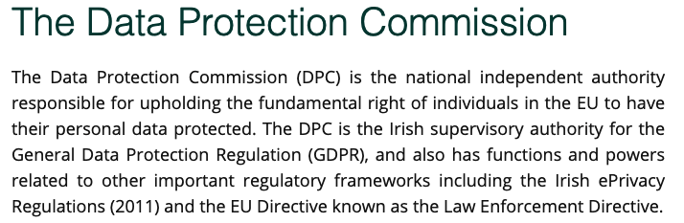
Independent public supervisory authority
If multiple authorities, representative of authority
(Art. 51.3)
Monitor application of GDPR
Protect rights
Facilitate flow of data
NO Processing by courts in judicial capacity (Art. 55)
Supervisory authorities
https://www.dataprotection.ie/
© Maria Grazia Porcedda 2024

Slide 28
Article 6: processing lawful processing only in these six cases
Processing lawful if
(at least one)
a) Consent
b) perform contract
c) legal obligation of data controller
d) vital interests of data subject
e) task carried out in the public interest
f) legitimate interests pursued by the controller
except where interests overridden by the interests/fundamental rights of the data subject
© Maria Grazia Porcedda 2023
Notes:
Guidelines2/2019
Legitimate interests: Unless carried out by public authorities in performance of their tasks

Slide 29
Article 5: Principles relating to processing of personal data
1. Personal data shall be…
[lawfulness, fairness and transparency]
[purpose limitation]
[data minimisation]
[accuracy]
[storage limitation]
[integrity and confidentiality]
[accountability]
1.a processed lawfully, fairly and in a transparent manner in relation to the data subject
1.b collected for specified, explicit and legitimate purposes and not further processed in a manner that is incompatible with those purposes;
1.c adequate, relevant and limited to what is necessary in relation to the purposes for which they are processed;
1.d accurate and, where necessary, kept up to date; every reasonable step must be taken to ensure that personal data that are inaccurate, having regard to the purposes for which they are processed, are erased or rectified without delay
1.e kept in a form which permits identification of data subjects for no longer than is necessary for the purposes for which the personal data are processed;
1.f processed in a manner that ensures appropriate security of the personal data, including protection against unauthorised or unlawful processing and against accidental loss, destruction or damage, using appropriate technical or organisational measures
2. The controller shall be responsible for, and be able to demonstrate compliance with
© Maria Grazia Porcedda 2023
Notes:
Zooma WP 260
Rec 50 compatible purposes are allowed

Slide 30
Accountability (responsibility) of controller(s): Article 24
How:
Measures are appropriate in relation to:
nature, scope, context and purposes of processing
risks (likelihood/severity) for rights and freedoms of natural persons
In line with data protection by design and by default (Art. 25) (EDPB 4/2019)
ensures + able to demonstrate that processing complies with GDPR
implement appropriate technical & organizational measures (updated as needed)
What:
© Maria Grazia Porcedda 2024
Notes:
Sufficient guarantees, recital 81: terms of expert knowledge, reliability and resources

Slide 31
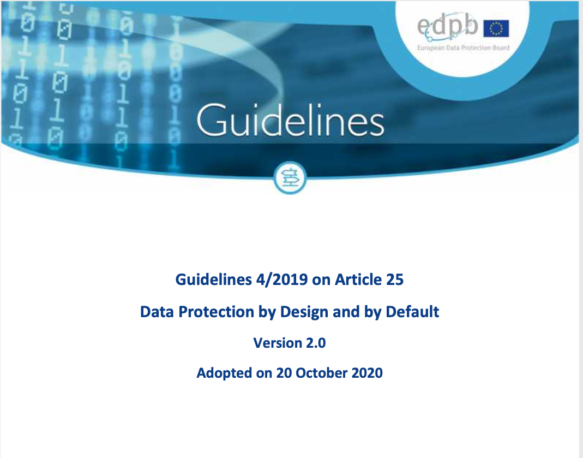
Article 24 (obligations of controller) & 25 (Data protection by design)
BONUS SLIDE
Art 25 (1) Data protection by design: implement appropriate technical and organisational measures…designed
Art 25 (2) Data protection by default: only personal data which are necessary for each specific purpose of the processing are processed → data minimization + purpose specification + storage limitation
to implement data protection principles…in an effective manner and
to integrate the necessary safeguards into the processing
in order to meet GDPR requirements + protect the rights of data subjects
Binding on controller: tech developer?
© Maria Grazia Porcedda 2024
Notes:
1. Taking into account the state of the art, the cost of implementation and the nature, scope, context and purposes of processing as well as the risks of varying likelihood and severity for rights and freedoms of natural persons posed by the processing, the controller shall, both at the time of the determination of the means for processing and at the time of the processing itself,
2. The controller shall implement appropriate technical and organisational measures for ensuring that, by default, only personal data which are necessary for each specific purpose of the processing are processed. That obligation applies to the amount of personal data collected, the extent of their processing, the period of their storage and their accessibility. In particular, such measures shall ensure that by default personal data aare not made accessible without the individual's intervention to an indefinite number of natural persons.

Slide 32
Applies to controller / processor- not tech developer!
Article 32: controller must ensure security of processing
1. Taking into account the state of the art, the costs of implementation and the nature, scope, context and purposes of processing as well as the risk of varying likelihood and severity for the rights and freedoms of natural persons, the controller and the processor shall implement appropriate technical and organisational measures to ensure a level of security appropriate to the risk, including inter alia as appropriate:
(a) the pseudonymisation and encryption of personal data;
(b) the ability to ensure the ongoing confidentiality, integrity, availability and resilience of processing systems and services;
(c) the ability to restore the availability and access to personal data in a timely manner ….
(d) a process for regularly testing, assessing and evaluating the effectiveness of technical and organisational measures for ensuring the security of the processing.
© Maria Grazia Porcedda 2024

Slide 33
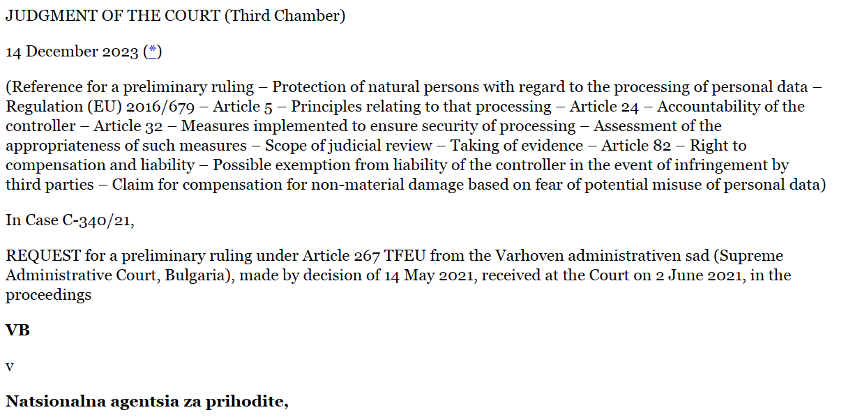
Part 4: how does the GDPR interact with tech? The NAP court case
Moral entitlements
Primary law
Secondary law
Other ‘law’
Technology
Charter, TFEU
GDPR
National law, international standards
Technical measures
Adapted from Porcedda (forthcoming 2024)
©2024 Maria Grazia Porcedda
Notes:
“Why walk down stairs when you can slide into your pool? Why trudge up stairs when you take an elevator that matches your dress?”

Slide 34
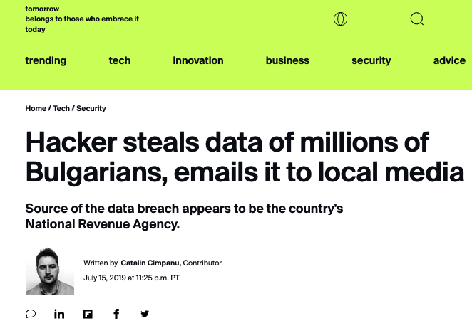
The Natsionalna agentsia za prihodite (NAP) case (first on data breaches)
VB took Bulgarian National Revenue Agency (NAP) to court to ask for compensation for non-material damage following hack
Compensation based on the GDPR, NAP as data controller
If EU rules are unclear, national courts cannot interpret them, must ask the Court of Justice of the European Union (CJEU)
CJEU has exclusive power to interpret EU law
Sources: https://www.zdnet.com/article/hacker-steals-data-of-millions-of-bulgarians-emails-it-to-local-media/ ; https://europeanlawblog.eu/2024/01/23/the-gdpr-as-a-cyber-risk-management-system-the-ecj-cautiously-tackles-data-breaches-in-the-nap-case/
© Maria Grazia Porcedda 2024

Slide 35
Questions 1 and 2
§ 22) if Articles 24 and 32 of the GDPR [mean] that unauthorised disclosure of personal data or unauthorised access to those data by a ‘third party…are sufficient, in themselves, for it to be held that the technical and organisational measures implemented by the controller in question were not ‘appropriate’, within the meaning of Articles 24 and 32.
§40) if Article 32 of the GDPR [means] that the appropriateness of the technical and organisational measures implemented by the controller, under that article, must be assessed by the national courts in a concrete manner, in particular by taking into account the risks associated with the processing concerned.
©2024 Maria Grazia Porcedda

Slide 36
Question 3
BONUS SLIDE
§48) if the principle of accountability of the controller [Articles 5(2) + 24 GDPR] [means] that, in an action for damages under Article 82 [GDPR], the controller in question bears the burden of proving that the security measures implemented by it are appropriate under Article 32 [GDPR].
§ 58) if Article 32 of the GDPR [means] that, in order to assess the appropriateness of the security measures implemented by the controller under that article, an expert’s report constitutes a necessary and sufficient means of proof.
©2024 Maria Grazia Porcedda

Slide 37
Questions 4 and 5
BONUS SLIDE
§ 65) if Article 82(3) of the GDPR [means] that the controller is exempt from its obligation to pay compensation for the damage suffered by a data subject, under Article 82(1) and (2) [GDPR], solely because that damage is a result of unauthorised disclosure of, or access to, personal data by a ‘third party’, within the meaning of Article 4(10) [GDPR].
§75 if Article 82(1) of the GDPR [means] that the fear experienced by a data subject with regard to a possible misuse of his or her personal data by third parties as a result of an infringement of that regulation is capable, in itself, of constituting ‘non-material damage’ within the meaning of that provision.
©2024 Maria Grazia Porcedda

Slide 38
How to read a case
HOW TO READ A CASE
Understand what law the case is about
Understand what the referring court is asking
Understand how the CJEU answers the question asked
Understand the implications of the answer
EXERCISE
In groups of three, read excerpts from Q1 or Q2, then write on the BB forum
What articles of the GDPR does the CJEU interpret?
What is the answer in lay person’s terms?
What is the implication?
© Maria Grazia Porcedda 2024
Notes:
How to read CJEU judgments: (Facts) + Points of law referred + Legal reasoning + Decision
Q 1 22-39
Q 2 40 - 47
Q 3 48 – 57 (second part not necessary)
Q 4 65- 74
Q5: 75- 86

Slide 39

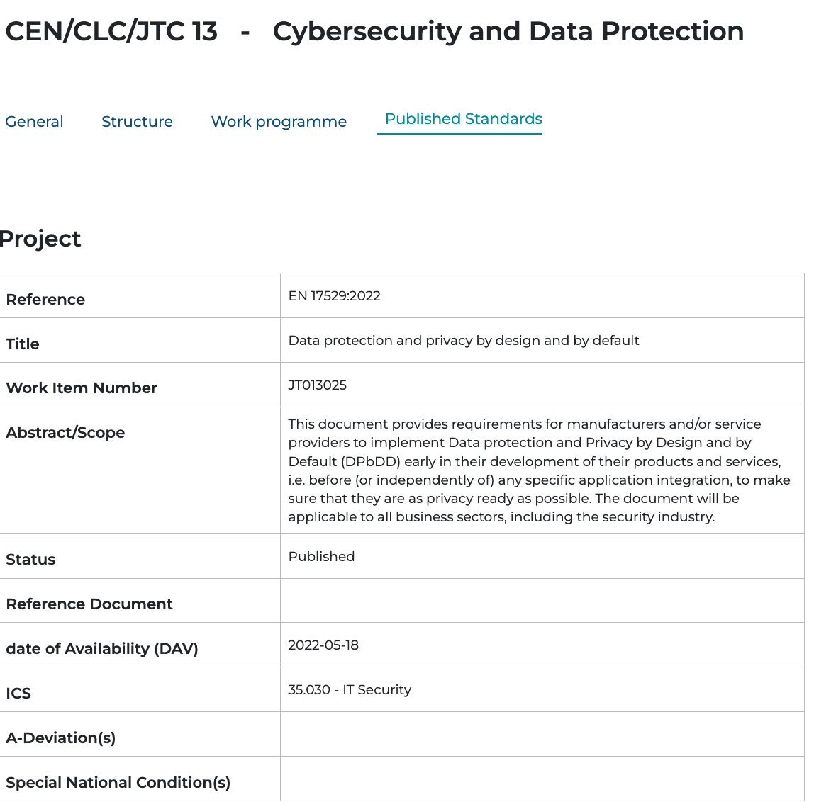
Appropriate measure tied to standards and state of the art
Sources: https://standards.cencenelec.eu/dyn/www/f?p=CEN:110:0::::FSP_PROJECT,FSP_ORG_ID:63633,2307986&cs=11F702120AA40D5CC2DD42848140B1806; https://www.enisa.europa.eu/publications/data-protection-engineering ; https://www.rfc-editor.org/rfc/rfc6973.txt
© Maria Grazia Porcedda 2024

Slide 40
Conclusions: the reality of the GDPR
Primary law
Secondary law
Other ‘law’
Technology
Charter, TFEU
GDPR
International standards, national laws
Moral entitlements
Technical measures
Adapted from Porcedda (forthcoming 2024)
© Maria Grazia Porcedda 2024
Notes:
“Why walk down stairs when you can slide into your pool? Why trudge up stairs when you take an elevator that matches your dress?”

Slide 41
Many thanks for your attention maria-grazia.porcedda At tcd.ie

Slide 42
References (plus links in slides)
Julie Cohen, ‘What privacy is for’, Harvard Law Review (2013) 126
Lawrence Lessig, The Law of the Horse: What Cyberlaw might teach (1999) 113 Harvard Law Review 113, ideally read it all, but at a minimum focus on pp. 501-514.
Orla Lynskey, 'Deconstructing data protection: the "added-value" of a right to data protection in the EU legal order' International and Comparative Law Quarterly (2014) 63 (3) pp. 569-597
J Reidenberg, Lex Informatica: the Formulation of Information Policy Rules Through Technology (1998) 76 Texas Law Review, pp. 553
Maria Grazia Porcedda, Cybersecurity, Privacy and Data Protection in EU law (Hart Publishing 2023)
Maria Grazia Porcedda, The GDPR as a cyber risk management system: the ECJ cautiously tackles data breaches in the NAP case (European Law Blog 4/2024)
Maria Grazia Porcedda, The Effacement of Information Technology from EU Law: The Need for Collabora0ve Approaches to Redesign the EU’s Regulatory Architecture, in F. Bieker, S. De Conca, I. Schiering, N. Gruschka. M. Jensen, Proceedings of the 18th IFIP Summer School 2023, Advances in Information and Communication Technology (due 27 May 2024) https://link.springer.com/book/9783031579776
Warren and Brandeis, ‘The Right to Privacy’, Harvard Law Review (1890) 4 (5)

Slide 43
Should you wish to read more of my work…
TCD profile:
https://www.tcd.ie/research/profiles/?profile=mariagrp
SSRN page:
https://papers.ssrn.com/sol3/cf_dev/AbsByAuth.cfm?per_id=1923160
EUI Cadmus page:
https://cadmus.eui.eu/browse?type=author&value=PORCEDDA,%20Maria%20Grazia

